Slide 1
Today: Brief Tour of 3 Case studies
As “Probability Engineers,” key point is that the type of analytical methods we cover in this subject can be beneficially applied to a very wide range of problem domains.
Richard Larson 1.203J, 15.073J, IDS.700 November 22, 2017

Slide 2
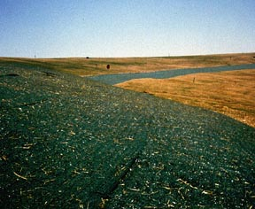
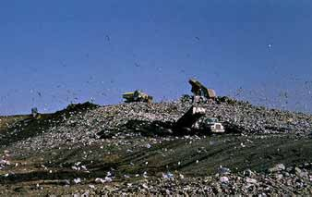
Case Study: Barges Bringing Urban Refuse to Fresh Kills Landfill, New York City * Richard Larson 1.203J, 15.073J, IDS.700 November 22, 2017

Slide 3
Purpose: To design a strategic planning model for the New York City Department of Sanitation (NYDOS) as a basis for a multi-million dollar capital investment in its barge fleet system.
Description: Over a decade encompassing three contracts, we designed and created a sequence of ever more sophisticated planning models for NYDOS.
During the process, we invented the concept of strategic inventory/routing systems.

Slide 4

A R G E
PERATION
YSTEM
IMULATOR
Richard C. Larson
Alan S. Minkoff

Slide 5
Fleet Sizing on a Transportation Network with Queues, Using Monte Carlo Simulation
60 to ???
Double the load,
what happens to fleet size?
Time Out for Analysis

Slide 6
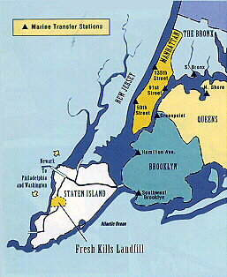
Map of New York City

Slide 7
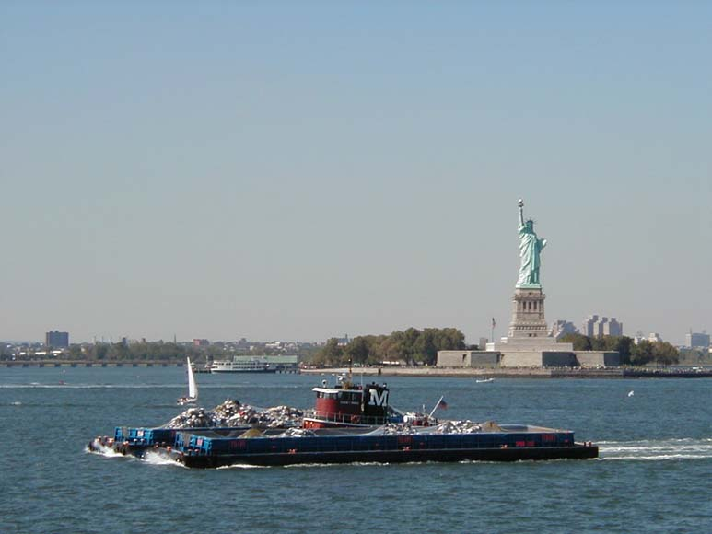
Barges in Action
http://www.fuzzyco.com/bare/nyif/Images/big/garbageliberty.jpg

Slide 8
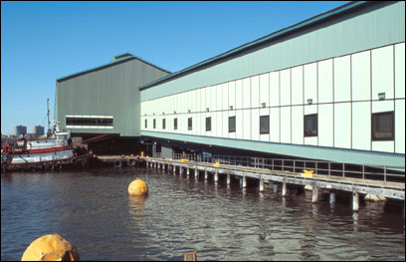
Marine Transfer Station
http://www.dattner.com/html/civic1a.html

Slide 9
BOSS: Marine Transfer Station
Tug
Delivers
LIGHTS
Tug
Picks Up
HEAVIES
LIGHT and HEAVY
Barges Stored
Loading
Barge
Barges
Shifted
By Hand
Or Tug
Refuse
Inflow
λ_{i} (t)
Loading
Barge

Slide 10
BOSS: Staging Area
TUGS
TUGS
LIGHT BARGE
LIGHT BARGE
PIER
HEAVY BARGE
HEAVY BARGE
TUGS
TUGS

Slide 11
Boss: Waterway Link
ORIGIN
WEATHER
DISPATCHER
INSTRUCTION VIA RADIO
TIDES
DESTINATION

Slide 12
Boss: Fresh Kills Landfill
TUG
DELIVERS
HEAVIES
Digger
HEAVY BARGES
UNLOADING
BARGE
REFUSE
UNLOADED
HEAVY BARGES
TUGS PICK
UP LIGHTS
UNLOADING
BARGE
LIGHT
BARGES
Digger

Slide 13
From Long Range to Short Range Decisions
1. Long range or strategic planning options
2. Short range configuration forced by planned or unplanned service outages
3. Very short range or tactical decisions made as a consequence of the dispatcher’s actions
BOSS MOST USEFUL FOR 1 AND 2 ABOVE

Slide 14
Illustrative BOSS Performance Measures
1. Cost per ton of refuse transported
2. Personnel cost per day
3. Tug system cost per day
4. The mean time between the filling of a barge and the emptying of a barge (this could be categorized by MTS)
5. Mean fraction of barges full and mean fraction of barges empty
6. Mean fraction of time that a tug is dead-heading (dead-heading means movement on a transportation link with no barges in tow)
7. Mean number of full barges per tow and mean number of empty barges per tow
8. Mean queuing time at FKL
9. Mean time that a barge resides full at a staging area

Slide 15
Models as Planning Tools
Appropriate for logistical systems
Model complexity Vs. policy relevance
Hazards of modeling - Huge data requirements - Lack of user understanding - Lack of broad-based user constituency - Trying to do too much
Need for interactive modeling

Slide 16
Desired Input Data
1. Travel times from point to point in the harbor area as a function of tidal conditions
2. Capacities and operating characteristics of each of the MTS’s
3. A description of current dispatching procedures
4. A description of current constraints with regard to barge and personnel scheduling
5. Aggregate amounts of refuse delivered to each of the MTS’s by day of the week (in tons)
6. Aggregate cost figures for various parts of the system

Slide 17
Potential Operational Changes that Could be Examined with the Model
1. Changing the number and/or locations of the MTS’s
2. Changing the number and/or locations of the staging areas
3. Changing the number of barges and/or tugs
4. Changing the number and/or unloading rates of the on-shore cranes at FKL
5. Analyzing the effects of service outages
6. Changing the dispatching algorithm
7. Analyzing the effects of staggered shifts
8. Analyzing the effects of barges of different sizes
9. Analyzing the effects of tugs having different operating characteristics (e.g.., horsepower)
10. Analyzing the effects of closing certain facilities during certain hours

Slide 18
Illustrative Monte Carlo Simulation Event Types
1. Unit arrives at node
2. Barge begins to be filled
3. Barge filled
4. Unit leaves node
5. Barge begins to be emptied
6. Barge emptied
7. Dispatch operation

Slide 19
Summary Transportation Network Diagram Describing a Simulation BOSS
Tidal
Effects
R1
1
R2
Transportation
Network
2
FKL
RJ
J
MTS’s
Movable Units
Barges
Tugs
Incoming
Refuse
Dispatch
Algorithm

Slide 20
Micro-states at the Network Sources and Sink
Barge K Empty
No loading
Barge K Empty
Being Loaded
Barge K Full
Awaiting Tow
(a) Marine Transfer Station
Barge K Full
Awaiting Crane
Barge K Full
Being Emptied
Barge K Empty
Awaiting Tow
(b) Fresh Kills Landfill

Slide 21
Detailed Depiction of the Transportation Network
MTS1
SA1
MTS2
SA2
MTS3
MTS3
SA7*
MTSJ
SAK
Marine
Transfer
Stations
Fresh
Kills
Landfill
Staging
Areas
(*) “dummy staging area”
for straight through tow

Slide 22
Sample Tugboat Journey
3
6
4
MTS1
5
MTS2
2
7
SA
1
8
FKL
MTS - Marine Transfer Station
FKL - Fresh Kills Landfill
SA - Staging Area

Slide 23
BOSS: Dispatch Algorithm
TIME NOW: 2:00 PM
One tug ready
for dispatch
FKL
SA 1
SA 2
MTS
1-A
MTS
1-B
MTS
2-A
MTS
2-B
NEXT BLOCKAGE TIMES

Slide 24
Client Impact: Each of the three deliverables
had a major impact. The first simulation model, Barge Operations System Simulator (BOSS), saved the City of New York over $20 million by revealing that the required barge fleet could be significantly smaller than others had told them. From that application alone, the City’s return on investment had a ratio of 200 : 1. Subsequently, the ever more sophisticated models were used in routine planning, such as revising operations during maintenance and repair, and in significant expansion using “resource recovery”. Total financial impact was in the vicinity of $50 million.

Slide 25
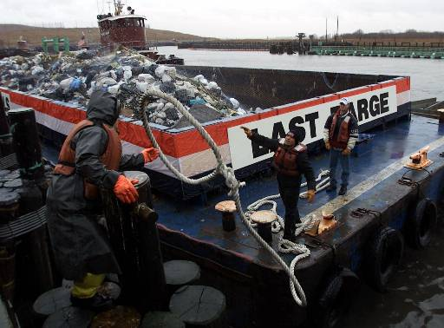
http://www.herb.lsa.umich.edu/kidpage/ZZZ/FreshKillsdemise.jpg

